Slide 1
Cryptography III
Public-key systems, digital signatures, hash functions

Slide 2
Weaknesses of symmetric cryptosystems
Managing and distributing shared secret keys is so difficult in a model environment with too many parties and relationships
  N parties ➔ n(n-1)/2 relationships ➔ each manages (n-1) keys
No way for digital signatures
  No non-repudiation service

Slide 3
Diffie-Hellman new ideas for PKC
In principle, a PK cryptosystem is designed for a single user, not for a pair of communicating users
  More uses other than just encryption
Proposed in Diffie and Hellman (1976) “New Directions in Cryptography”
  public-key encryption schemes
  public key distribution systems
    Diffie-Hellman key agreement protocol
  digital signature

Slide 4
Diffie-Hellman’s proposal
Each user creates 2 keys: a secret (private) key and a public key → published for everyone to know
  The PK is for encryption and the SK for decryption
      X = D(z, E(Z, X))
  The SK is for creating signatures and the PK for verifying these signatures
      X = E(Z, D(z, X)) → D() for creating signatures, E → verifying
Also, called asymmetric key cryptosystems
  Knowing the public-key and the cipher, it is computationally infeasible to compute the private key

Slide 5
RSA Algorithm
Invented in 1978 by Ron Rivest, Adi Shamir and Leonard Adleman
  Published as R L Rivest, A Shamir, L Adleman, "On Digital Signatures and Public Key Cryptosystems",Communications of the ACM, vol 21 no 2, pp120-126, Feb 1978
  Security relies on the difficulty of factoring large composite numbers
Essentially the same algorithm was discovered in 1973 by Clifford Cocks, who works for the British intelligence

Slide 6
Main idea
Encryption and decryption functions are modulo exponential in the field Z_{n}= {0,1,2,..n-1}
  Encryption: Y=Xe mod n (or ± n)
    a = b ±n ➔ a=b+k*n, a∈Z_{n}, k = 1,2,3,... e.g. 7 = 37 ±10
  Decryption: X= Y^{d}±n
  The clue is that e & d must be selected such that
  X^{ed}= X (mod n)

Slide 7
Main idea
The way to create such e&d is by using this Euler theorem: X^{φ(n)}=1 (mod n)
  φ(n): the size of Z*_{n} = {k:0<k<n| (k,n)=1}
  φ(n) can be computed easily if knowing n factoralization
    n= p*q, where p, q are primes ➔ φ(n) = (p-1)(q-1)
  First choose e then compute d s.t. e*d= 1± φ(n)
  or d ≡ e⁻¹mod φ(n), which will assure that
    X^{ed}= X^{k.φ(n)+1}≡ (X^{φ(n)})^{k} *X ≡ 1^{k} * X = X (mod n)
Note this works because we know n’s factorization
  From e we compute d ≡ e⁻¹mod φ(n) since we know φ(n), otherwise it is computational infeasible to compute d s.t. X^{ed} ≡ 1 mod n

Slide 8
RSA PKC
Key generation:
  Select 2 large prime numbers of about the same size, p and q
  Compute n = pq, and Φ(n) = (q-1)(p-1)
  Select a random integer e, 1 < e < Φ(n), s.t. gcd(e, Φ(n)) = 1
  Compute d, 1< d< Φ(n) s.t. ed ≡ 1 mod Φ(n)
  Public key: (e, n) and Private key: d
    Note: p and q must remain secret

Slide 9
RSA PKC (cont)
Encryption
  Given a message M, 0 < M < n: M∈Z_{n}− {0}
  use public key (e, n) compute
  C = Me mod n, i.e. C ∈ Z_{n}− {0}
Decryption
  Given a ciphertext C, use private key (d) compute M = C^{d} mod n
Why work?
  (Me mod n)^{d} mod n = M^{ed} mod n = M

Slide 10
Example
Parameters:
  Select p = 11 vàq = 13
  n=11*13=143; m= (p-1)(q-1) =10 *12=120
  Choose e=37 ➔ gcd(37,120=1
  Using the algo gcd: e*d =1 ±120 ➔ d= 13 (e*d=481)
To encrypt a binary string
  Split it into segments of u bit s.t. 2^{u}≤142 ➔ u = 7. That is each segment present a number from 0 to 127
  Compute Y= Xe±143
  E.g. For X = (0000010) = 2, we have
  Y= E_{Z}(X) = X³⁷= 12±143 ➔ Y=(00001100)
Decryption: X= D_{Z}(Y)=12¹³=2±143

Slide 11
Algorithm for computing modulo inverse
Computing the inverse of ω by modulo m
  Finding x = ω⁻¹ mod m such that x*ω = 1 (mod m)
  Many applications such as in the Knapsack trapdoor
Based on the extended GCD algorithm or the extended Euclidean algorithm (GCD: Greatest common divisor)
  On finding the GCD of 2 numbers n₁ và n₂, one will also compute a & b such that GCD(n₁, n₂) = a × n₁ + b × n₂.
  If gcd(n₁,n₂)=1 then this e-GCD algorithm will find a, b to meet a×n₁+b × n₂=1, i.e. n₁ is the inverse of a by modulo n₂

Slide 12
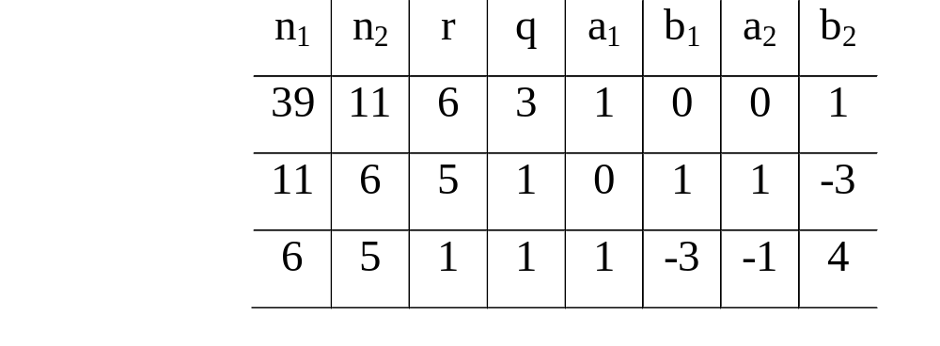
Homework: prove the correctness of this algorithm
Start
Numeric example: find the inverse of 11 by modulo 39
Let n₁=39, n₂=11 then run the algo as in the following table:
n₁, n₂
n₁>0
Initialization:
a₁=1, b₁=0
a₂ = 0, b₂ = 1
UPDATE:
n₁=n₂
n₂ = r
t=a₂
a₂ = a₁ - q* a₂
a₁ = t
t=b₂
b₂=b₁-q*b₂
b₁ = t
Compute quotient q and remainder r
when n₁ is divided by n₂
No
yes
g = n₂
a = a₂
b = b₂
r=0
g,a,b

Slide 13
General remarks on PKC
Since 1976,many PKC schemes had been proposed many was broken
A PKC have two main applications
  Hiding information (including secrete communication)
  Authentication with digital signatures
The two algorithms that are most successful are RSA và El-Gamal.
In general PKC is very slow, not appropriate for on-line encryption
  Not used for encrypting large volume of date but for special purposes.
  PKC and SKC are used in combined:
    Alice and Bob use a PKC system to create a shared secret key between them and then use a SKC system to encrypt the communicated data by using this secret key

Slide 14
RSA implementation
n, p, q
  The security of RSA depends on how large n is, which is often measured in the number of bits for n. Current recommendation is 1024 bits for n.
  p and q should have the same bit length, so for 1024 bits RSA, p and q should be about 512 bits.
  p-q should not be small
  Way to select p and q
    In general, select large numbers (some special forms), then test for primality
    Many implementations use the Rabin-Mille test, (probabilistic test)

Slide 15
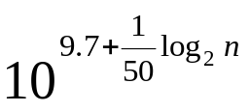
Factorization Prolem
Estimated time using the sieve algorithm
  L(n) ≈
  log₂n: the number of bits in representing n
  By 1996, for n=200, L(n) ≈ 55,000 years.
  Using parallel computing, one can factorize a 129–digit number in 3 months by distributing the workload to the computers throught out the Internet at 1996-7
  Today, for applications requiring high security levels one should values of in 1024-bit or even 2048-bit.
Van K Nguyen --Dai hoc Bach khoa Ha noi

Slide 16
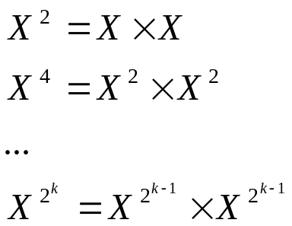
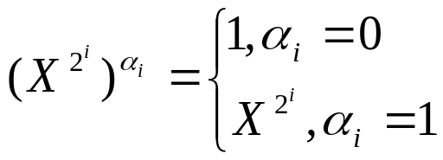
Modulo Exponential
Fast algorithm to compute exponential in Z_{n} (modulo n):
  Computing X^{α} (modul n)
Determine coefficients α_{i} in the binary representation of α :
α = α₀2⁰ + α₁2¹ + α₂2² + ... + α_{k}2^{k}
Loop in k rounds to compute these k modulo exponential, với i=1,k :
Now compute X^{α} mod n by multiplying theses X^{2i} computed in the previous steps but only with corresponding coefficients α_{i} =1:
Van K Nguyen --Dai hoc Bach khoa Ha noi

Slide 17
Digital Signatures
Motivation
  Diffie-Hellman proposed the idea (1976)
  Simulation of the real-world into digital worlds
    Paper contracts need signed to be valid so do electronic versions
The proofs conveyed in signatures
  Data integrity: information is original, not modified
  Authentication: The source of the info is correct, not impersonated

Slide 18
DS: how they work
Digital Signature: a data string which associates a message with some originating entity.
Digital Signature Scheme:
  a signing algorithm: takes a message and a (private) signing key, outputs a signature
  a verification algorithm: takes a (public) key verification key, a message, and a signature
A DS is created based on a PK system
  Alice signs message X by creating Y=D_{zA}(X), so the signed document now is (X, Y=D_{zA}(X)).
  Bob who receives (X,Y), computes X’=E_{ZA} (Y) then compare if X=X’ to confirm the document’s validity

Slide 19
Non-repudiation
We mention more on applications of DS
Non-repudiation
  The signer can’t deny that his/her created the document
    Only Alice knows z_{A} to create (X, Y=D_{zA}(X)) but everyone else can verify
  So we say the DS scheme provides non-repudiation

Slide 20
Public notary
Motivation
  Alice may lost her secret key or someone stole it ➔ that bad guy can impersonate Alice to create documents with Alice signatures out of Alice’s control
  Alice can also deny a document truly signed by her in the past: Alice claims the document was impersonated by someone stealing her SK
Solution: Public notary service
  A third party – a public notary – can be hired for important documents
  The trusted notary also signs on the same document, that is to create his signature on the concatenation of the document and Alice’s signature

Slide 21
Proof of delivery (receipts)
Motivation
  The sender need proof that the receiver has already got his message
  The receiver can’t deny that once the sender got a receipt
Solution: An adjudicated protocol
  A→B: Y=EZ_{B}(Dz_{A} (X))
  B computes: X’=EZ_{A}(Dz_{B} (Y))
    When receiving Y, B computes and checks if X’=X then signs on X’ and pass to A as a receipt .
  B→A: Y=EZ_{A}(Dz_{B} (X’))
    By computing Dz_{A} (Y), A now gets Dz_{B} (X’), a B’s signature on X
  Only when A has Y she can consider that B has receive her doc
  Later, B can not deny receiving X since A can prove otherwise by showing Dz_{B} (Y))

Slide 22
Weakness of the signature scheme mentioned so far
When using a PKC to sign X, X can be long ➔ splitting into blocks and signs
  X = (X₁, X₂, X₃, ... X_{t} ) ➔(SA(X₁), SA(X₂), SA(X₃), ... SA(X_{t}))
This creates vulnerability to attack on manipulating blocks
  The attacker can change order of blocks, remove/ add in a few
Slow: PKC is already slow, now is run multiple times
Signature is long, as long as the message itself.

Slide 23
Hash Functions
A hash function H maps a message of variable length n bits to a fingerprint of fixed length m bits, with m < n.
  This hash value is also called a digest (of the original message).
  Since n>m, there exist many X which are map to the same digest ➔ collision.
Applications
  Digital signatures
  Message authentication

Slide 24
DS schemes with hash functions
X
H
H(X)
D_{A}
Concatenation
X.D_{A}(H(X))
C
Signature Generator
E_{A}
X.D_{A}(H(X))
0 – Accept
1 – Reject
+
H
Signature Verifier

Slide 25
Main properties
Given a hash function H: X →Y
Long message → short, fixed-length hash
One-way property: given y ∈Y
  it is computationally infeasible to find a value x∈X s.t. H(x) = y
Collision resistance (collision-free)
  it is computationally infeasible to find any two distinct values x’, x ∈ X s.t. H(x’) = H(x)
  This property prevent against signature forgery

Slide 26
Collisions
Avoiding collisions is theoretically impossible
  Dirichlet principle: n+1 rabbits into n cages ➔ at least 2 rabbits go to the same cage
  This suggest exhaustive search: try |Y|+1 messages then must find a collision (H:X→Y)
In practice
  Choose |Y| large enough so exhaustive search is computational infeasible.
    |Y| not too large or long signature and slow process
  However, collision-freeness is still hard

Slide 27
Birthday attack
Can hash values be of 64 bits?
  Look good, initially, since a space of size 2⁶⁴ is too large to do exhaustive search or compute that many hash values
  However a birthday attack can easily break a DS with a 64-bit hash function
    In fact, the attacker only need to create a bunch of 2³² messages and then launch the attack with reasonably high probability for success.

Slide 28
How is the attack
Goal: given H, find x, x’ such that H(x)=H(x’)
Algorithm:
  pick a random set S of q values in X
  for each x∈S, computes h_{x}=H(x)
  if h_{x}=h_{x’} for some x’≠x then collision found: (x,x’), else fail
The average success probability is
  ε= 1-exp(^{q(q-1)}/_{2|Y|})
  Suppose Y has size 2^{m}, choose q ≈2^{m/2} then ε is almost 0.5!

Slide 29
Birthday paradox
Given a group of people, the minimum number of people
  such that two will share the same birthday with probability at least 50%
is only 23 ➔ why “paradox”
  Computing the chance
    1 - (1- 1/365)(1-2/365)…(1-22/365) = 1-0.493 = 0.507

Slide 30
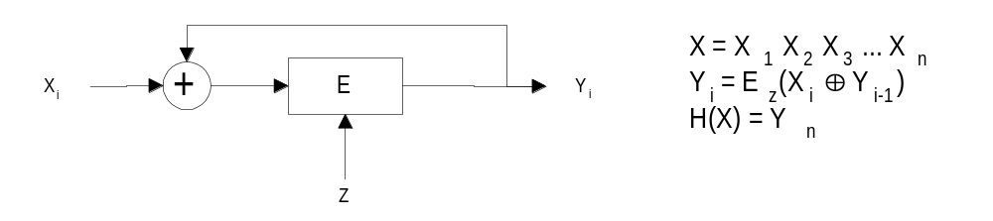
Common techniques to build hash functions
Using SKC
  E.g. using SKC in CBC mode
Using modulo arithmetic operations
Specific designs
  MD4, MD5, SHA

Slide 31
MAC: message authentication code
Hash function is public and the key shared between the sender and the receiver is secret
  Sender computes mac1 = MAC(M, H, K) and sends it along with the message M
  Receiver computes mac2 = MAC(M, H, K) and checks if mac1 = mac2 ? Yes ➔ the message is authentic; no => reject it
The output of MAC can not be produced without knowing the secret key
  So, this mechanism provides data integrity and source authentication

